Slide 1
Annual Interagency Accessibility Forum
Unlocking the Power of Accessibility
October 11-13, 2022
Captioning Multimedia – Is It As Complicated As It Sounds?
Lesley Earl, Ph.D

Slide 2
Outline
Caption types and requirements
Captioning guidelines
Workflow:
Tools and tricks for generating transcripts
Ideas for translating speech to text
Generating timed captions
Posting captions with videos
Q&A

Slide 3
Captioning: Types and Requirements

Slide 4
Section 508 – Synchronized Media
Pre-recorded Synchronized media (Video and Audio)
Level A: Captions are provided for all pre-recorded audio content in synchronized media
Live Synchronized media (Video and Audio)
Level AA: Captions are provided for all live audio content in synchronized media
https://www.w3.org/TR/WCAG20/

Slide 5
Captions: a definition
synchronized visual and/or text alternative
for both speech and non-speech audio information
needed to understand the media content
https://www.w3.org/TR/WCAG20/

Slide 6
Additional guidance and explanation
Captions convey not only the content of spoken dialogue, but also non-dialogue audio information needed to understand the program content
Closed Captions can be turned on and off
Open Captions are any captions that cannot be turned off
Captions should not obscure or obstruct relevant information in the video
In some countries, captions are called subtitles
Audio descriptions can be, but do not need to be, captioned since they are descriptions of information that is already presented visually
https://www.w3.org/TR/WCAG20/

Slide 7
Captioning Guidelines

Slide 8
Writing and editing captions
Captions should…
display in time with the audio content (“timed captions”)
include informational non-speech content
not cover any visual information on-screen
adhere accurately* to spoken words and conversation
use correct capitalization, punctuation, and grammar, as appropriate
indicate speaker when not visually obvious
*You may edit out “ums”, repeated words, etc, for clarity in some cases

Slide 9
Captioning Workflow

Slide 10
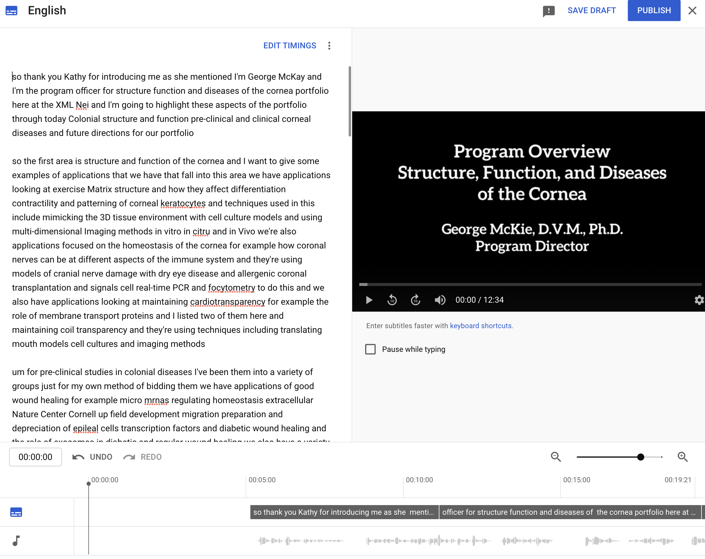
Generate a transcript
Auto-transcription applications
YouTube*
Otter.ai
Adobe Premiere Pro*
Zoom (for recorded meetings)
Note: you may need to strip out time codes and other extraneous information

Slide 11
Fix your transcript
Adhere to spoken words
Punctuation & capitalization
Verify correct spelling of names, places
“Cleaning” the text – ums, ahs, and other habitual sounds/words
Add description of informational audio events
What if you can’t understand?
Verify technical information with experts

Slide 12
Choose your caption style!

Slide 13

How would you caption this clip?
The screens that I'm mostly talking about are phones and tablets. The types of screens that use up – that you use up close, and ophthalmologists and optometrists were all observing a trend in children – um – in the last several years of developing – of those children developing…
Option 1
Option 2
The screens that I'm mostly talking about are phones and tablets, the types of screens that use up – that you use up close. And ophthalmologists and optometrists were all observing a trend in children, in the last several years of developing – of those children developing…
Option 3
The screens that I'm mostly talking about are phones and tablets, the types of screens that you use up close. And ophthalmologists and optometrists, we’re all observing a trend in children, in the last several years, of those children developing…

Slide 14
Creating timed captions from a transcript
Caption files include:
Caption number
Caption start and end timecodes
Caption text
Caption placement/ style (sometimes)
Options for generating timings:
Manual (Premiere, YouTube, etc)
Premiere workflow
YouTube from untimed transcript
Example of SRT captions with caption sequence, time code, and captioned text.
1
00:00:06,300 --> 00:00:08,166
Oh, hi. I didn't see you there.
2
00:00:08,166 --> 00:00:09,566
My name is Santana, and I'm here.
3
00:00:09,566 --> 00:00:11:566
To tell you about the impact
I hope to make on
4
00:00:11,566 --> 00:00:13,700
The scientific community
In 10 to 20 years.

Slide 15
Captions and video display…
There are LOTS of caption file types, but two are most common:
VTT (or WEBVTT)
Used for Microsoft services including Stream, YouTube, many other players (not Adobe or most social media)
Human-readable time codes and captions
No customization of caption placement
SRT
Used for YouTube, social media, Adobe, and many other players
Human-readable time codes and captions
Some customization of caption placement (for certain players)

Slide 16
Captions and Social Media
Platform | Accepted Closed Caption file types | Includes caption toggles | Includes automated captions | More information
Twitter | SRT | Yes | Yes | https://help.twitter.com/en/using-twitter/upload-caption-srt-file
Facebook | SRT | Yes | Yes | https://www.facebook.com/help/261764017354370
LinkedIn | SRT | Yes | For livestream only | https://www.linkedin.com/help/linkedin/answer/a552177/add-closed-captions-to-videos-on-linkedin
Instagram | none | No (requires adjustment in settings) | Yes – must be edited in Instagram directly | https://www.alphr.com/add-captions-instagram-stories/

Slide 17
Demonstration: YouTube
Demonstration sample video: https://youtu.be/EDPknJVQbOA

Slide 18
Demonstration: Adobe Premiere Pro

Slide 19
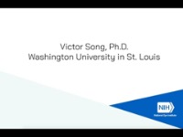
Example 1: Difficult-to-understand text
https://youtu.be/C_-vbcx8GIA?t=14

Slide 20

Example 2: Captioning Audio Description
https://youtu.be/NqwrCCh7vxU

Slide 21

Example 3: Where captions cover content
https://youtu.be/cpAVpIPHiaM

Slide 22
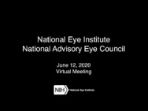
Example 4: Multiple speakers, non-speech content
https://youtu.be/-qfN7AQtqto

Slide 23
Questions???

Slide 24

Contact information
Lesley Earl, Ph.D.
Section 508 Coordinator/ Science Writer
National Eye Institute
lesley.earl@nih.gov

